Slide 1

Chapter 11
Unique Marketing Issues
Bruce R. Barringer
R. Duane Ireland
Copyright ©2016 Pearson Education, Inc.
11-<number>

Slide 2
Chapter Objectives
1 of 2
Explain the three steps (segmenting the market, selecting a target market, and establishing a unique marketing position) entrepreneurial firms use to identify their customers.
Define a brand and explain why it is important to an entrepreneurial firm’s marketing efforts.
Identify and explain the 4Ps of marketing activities (product, price, promotion, and place) used by entrepreneurial firms.
Copyright ©2016 Pearson Education, Inc.
11-<number>

Slide 3
Chapter Objectives
2 of 2
Describe the seven-step sales process an
entrepreneurial firm uses to identify prospects and
close sales.
Copyright ©2016 Pearson Education, Inc.
11-<number>

Slide 4
Selecting a Market and Establishing a Position in the Market
Important Questions That All Start-ups Must Ask
  In order to succeed, a new firm must address this important issue: Who are our customers and how will we appeal to them?
  A well-managed start-up approaches this query by following a three-step process:
    Segmenting the market.
    Selecting a target market.
    Establishing a unique position.
Copyright ©2016 Pearson Education, Inc.
11-<number>

Slide 5
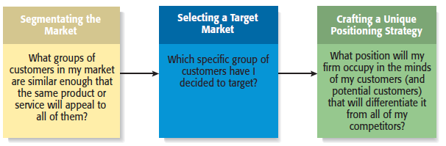
The Process of Selecting a Target Market and Positioning Strategy
Copyright ©2016 Pearson Education, Inc.
11-<number>

Slide 6
Market Segmentation
Involves studying a firm’s
industry and determining the
different target markets in that
industry.
Markets can be segmented in
a number of different ways,
including:
- Product type.
- Geography (city, state, region).
- Demographic variables.
Segmenting the Market
Copyright ©2016 Pearson Education, Inc.
11-<number>

Slide 7
Example: Segmenting the Dance Studio Market by Customers Served
Professional Dancing
Adult Dancing
Youth Dancing
Serious
dancers who aspire
to make a living
dancing in Broadway
plays.
Ballroom and other
types of dancing
for adults who want
to learn dance for
recreation and fun.
Ballet and other types of dancing for young girls who want to learn to dance to develop poise and grace.
Copyright ©2016 Pearson Education, Inc.
11-<number>

Slide 8
Selecting a Target Market
Once a firm has segmented
the market, a target market
must be chosen.
The market must be sufficiently
attractive and the firm must have
the capability to serve it.
By focusing on a clearly defined
market, a firm can become an
expert in that market and then
be able to provide customers a
high level of service.
Target Market
Copyright ©2016 Pearson Education, Inc.
11-<number>

Slide 9
Establishing a Unique Position
1 of 2
After selecting a target market, the
firm’s next step is to establish a
“position” within the market that
differentiates it from its rivals.
A “position” is the part of a market
that the firm is claiming as its own.
A firm establishes a unique
position in its customers’ minds
by drawing attention to two or
three of the product’s attributes.
Positioning
Copyright ©2016 Pearson Education, Inc.
11-<number>

Slide 10
Establishing a Unique Position
2 of 2
Positioning (continued)
  Firms often develop a “tagline” to reinforce the position they have staked out in their market, or a phrase that is used consistently in a company’s literature and thus becomes associated with the company.
  An example is Nike’s familiar tagline, “Just do it.”
    The beauty of this simple three-word expression is that it applies equally to a 21-year-old triathlete and a 65-year-old mall walker.
Copyright ©2016 Pearson Education, Inc.
11-<number>

Slide 11
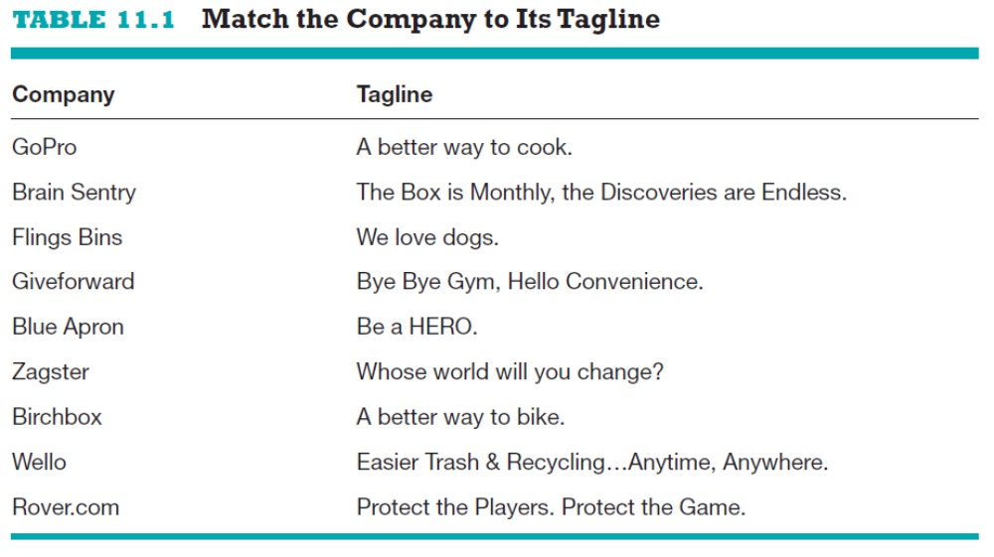
Taglines—Developed to Reinforce a Firm’s Positioning Strategy
Copyright ©2016 Pearson Education, Inc.
11-<number>

Slide 12
Branding
1 of 4
Establishing a Brand
  A brand is the set of attributes—positive or negative—that people associate with a company.
    These attributes can be positive, such as trustworthy, dependable, or easy to deal with.
    Or they can be negative, such as cheap, unreliable, or difficult to deal with.
  The customer loyalty a company creates through its brand is one of its most valuable assets.
Brand Management
  Some companies monitor the integrity of their brands through a program called “brand management.”
Copyright ©2016 Pearson Education, Inc.
11-<number>

Slide 13
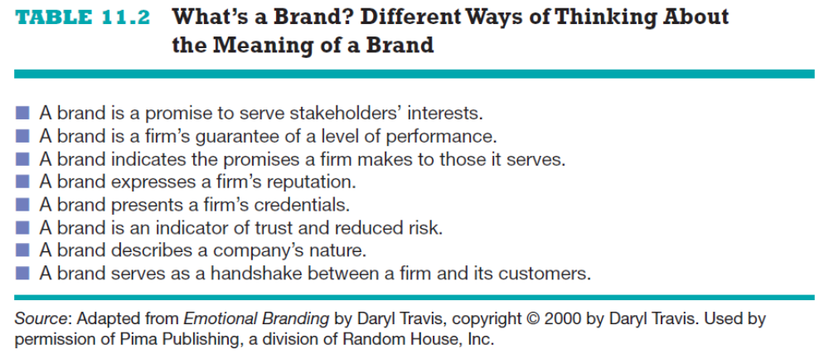
Branding
2 of 4
What’s a Brand?
Copyright ©2016 Pearson Education, Inc.
11-<number>

Slide 14
Branding
3 of 4
Establishing a Brand
  So how does a firm establish a brand?
    On a philosophical level, a firm must have meaning in its customers’ lives. It must create value—something for which customers are willing to pay.
    On a more practical level, brands are built through a number of techniques, including advertising, public relations, sponsorships, support of social causes, and good performance.
    A firm’s name, logo, Web site design, Facebook page, and even its letterhead are part of its brand.
Copyright ©2016 Pearson Education, Inc.
11-<number>

Slide 15
Branding
4 of 4
Power of a Strong Brand
  Ultimately, a strong brand can be a very powerful asset for a firm.
  Over 50% of consumers say that a known and trusted brand is a reason to buy a product.
  A brand allows a company to charge a price for its products or services that is consistent with its image.
  A successful brand can increase the market value of a company by 50% to 75%.
Copyright ©2016 Pearson Education, Inc.
11-<number>

Slide 16
The Four Ps of Marketing for New Ventures
Product
Price
Marketing Mix
Promotion
Place (or distribution)
Copyright ©2016 Pearson Education, Inc.
11-<number>

Slide 17
Product
Product
  Is the good or service a firm offers to its target market.
  The initial rollout is one of the most critical times in the marketing of a new product.
  All firms face the challenge that they are unknown and that it takes a leap of faith for the first customers to buy their products.
    Some start-ups meet this challenge by using reference accounts.
    A reference account is an early user of a firm’s products who is willing to give a testimonial regarding his or her experience with the produce.
Copyright ©2016 Pearson Education, Inc.
11-<number>

Slide 18
Core Product vs. Actual Product
Core Product
Actual Product
The product itself, such as an antivirus software program.
The product plus all the attributes that come with it such as quality level, features, design, packaging, and warranty.
Copyright ©2016 Pearson Education, Inc.
11-<number>

Slide 19
Price
Price
  Price is the amount of money consumers pay to buy a product.
  The price a company charges for its products sends an important message to its target market.
    For example, Oakley positions its sunglasses as innovative, state-of-the-art products that are both high quality and visually appealing.
    This position in the market suggests a premium price that Oakley charges.
  Most entrepreneurs use one of two methods to set the price for their products, as shown on the next slide.
Copyright ©2016 Pearson Education, Inc.
11-<number>

Slide 20
Core Product vs. Actual Product
Cost-Based Pricing
Value-Based Pricing
The list price is determined by adding a markup percentage to a product’s cost.
The list price is determined by estimating what consumers are willing to pay for a product.
Copyright ©2016 Pearson Education, Inc.
11-<number>

Slide 21
Promotion
Promotion
  Refers to the activities the firm takes to communicate the merits of its product to its target market.
  There are several common activities that entrepreneurs use to promote their products and services.
Advertising
  Advertising is making people aware of a product or service in hopes of persuading them to buy it.
Copyright ©2016 Pearson Education, Inc.
11-<number>

Slide 22
Pluses and Minuses of Advertising
Pluses
Raise customer awareness of a product.
Explain a product’s comparative features and benefits.
Create associations between a product and a certain lifestyle.
Minuses
Low credibility.
The possibility that a high percentage of people who see the ad
will not be interested.
Message clutter.
Relative costliness compared to other forms of promotion.
Intrusiveness.
Copyright ©2016 Pearson Education, Inc.
11-<number>

Slide 23
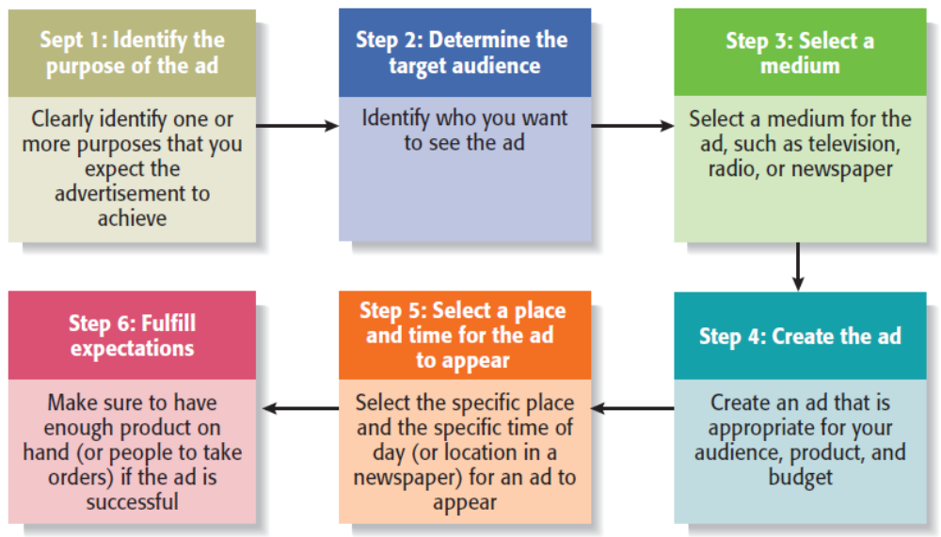
Steps Involved in Putting
Together an Advertisement
Copyright ©2016 Pearson Education, Inc.
11-<number>

Slide 24
Google AdWords and AdSense Program
1 of 2
AdWords
  Allows advertisers to buy keywords on the Google home page.
  Triggers text-based ads to the side of (and sometimes above) search results when the keyword is used.
  The program includes local, national, and international distribution.
  Advertisers pay a certain amount per click.
  Advertisers benefit because they are able to place their ads in front of people who are already searching for information about their product.
Copyright ©2016 Pearson Education, Inc.
11-<number>

Slide 25
Google AdWords and AdSense Program
2 of 2
AdSense
  Allows advertisers to buy ads that will be shown on other Web sites instead of Google’s home page.
  Google selects sites of interest to the advertiser’s customers.
  Advertisers are charged on a pay-per-click or a per-thousand impression basis.
  Advertisers benefit because the content of the ad is often relevant to the Web site.
  Web site owners benefit by using the service to monetize their Web site.
Copyright ©2016 Pearson Education, Inc.
11-<number>

Slide 26
Public Relations
Public Relations
  One of the most cost effective ways to increase the awareness of the products of a company is through public relations.
  Public relations refer to efforts to establish and maintain a company’s image with the public.
  The major difference between public relations and advertising is that public relations is not paid for—directly.
Copyright ©2016 Pearson Education, Inc.
11-<number>

Slide 27
Public Relations Techniques
Press release
Traditional media
coverage
Social media
coverage
Articles in industry
press and periodicals
Blogging
Monthly newsletter
Civic, social, and community
involvement
Copyright ©2016 Pearson Education, Inc.
11-<number>

Slide 28
Social Media
Social Media
  Consists primarily of blogging and connecting with customers and others through social networking sites like Facebook and Twitter.
Blogging
  The idea behind blogs is that they familiarize people with a business and help build an emotional bond between a business and its customers.
Facebook and Twitter
  Businesses establish a presence on Facebook and Twitter to build a community around their products and services.
Copyright ©2016 Pearson Education, Inc.
11-<number>

Slide 29
Other Promotions Techniques
Viral Marketing
Guerrilla Marketing
Facilitates and encourages people to pass along a marketing message about a particular product or service.
A low-budget approach to marketing that relies on ingenuity, cleverness, and surprise rather than traditional techniques.
Copyright ©2016 Pearson Education, Inc.
11-<number>

Slide 30
Place (or Distribution)
Place
  Encompasses all the activities that move a firm’s product from its place of origin to the consumer.
  The first choice a firm has to make regarding distribution is whether to sell its products directly to consumers or through intermediaries (such as wholesalers and retailers).
  Within most industries, both choices are available, so the decision typically depends on how a firm believes its target market wants to buy its product.
Copyright ©2016 Pearson Education, Inc.
11-<number>

Slide 31
Selling Direct Vs. Selling
Through an Intermediary
1 of 2
Approach to Distribution
Description
Selling Direct
Many firms sell direct to the customer, maintaining control of the distribution and sales process.
Selling Through Intermediaries
Other firms sell through intermediaries and pass off their products to wholesalers who place them in retail outlets to be sold.
Copyright ©2016 Pearson Education, Inc.
11-<number>

Slide 32
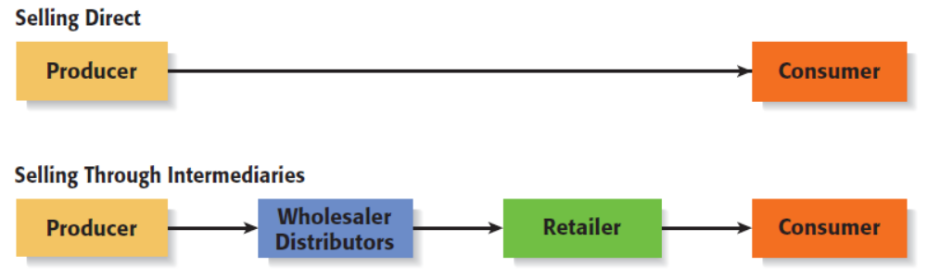
Selling Direct Vs. Selling
Through an Intermediary
2 of 2
Copyright ©2016 Pearson Education, Inc.
11-<number>

Slide 33
Sales Process
1 of 3
Sales Process
  A firm’s sales process (or sales funnel) depicts the steps it goes through to identify prospects and close sales.
  A formal sales process involves a number of identifiable steps.
Importance of Process
  Some companies simply wing it when it comes to sales, which isn’t recommended.
  It’s much better to have a well thought-out approach to prospecting customers and closing sales.
Copyright ©2016 Pearson Education, Inc.
11-<number>

Slide 34
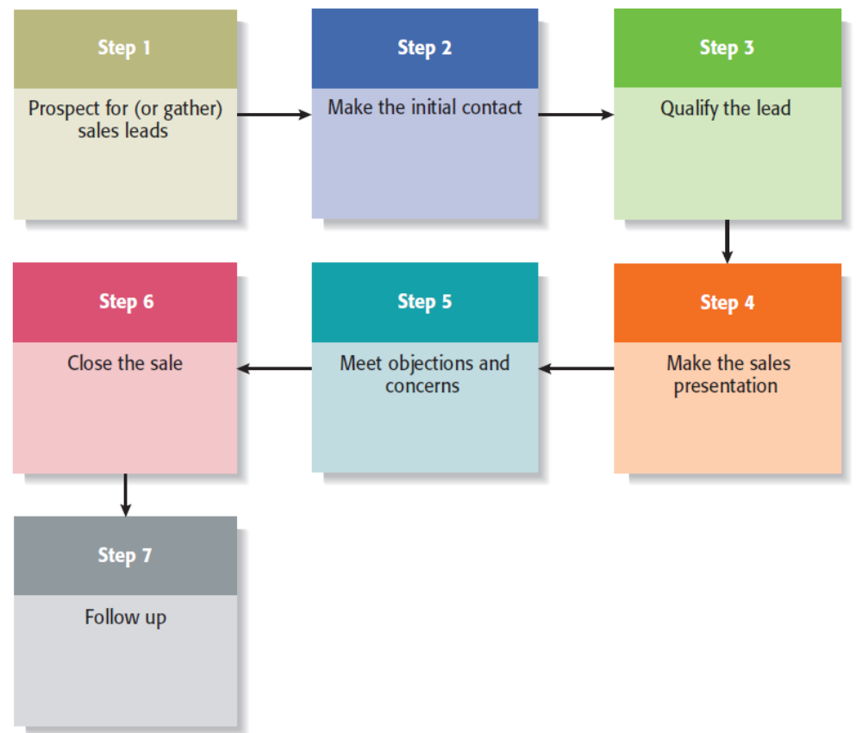
Sales Process
2 of 3
Copyright ©2016 Pearson Education, Inc.
11-<number>

Slide 35
Sales Process
3 of 3
Usefulness of Sales Process
  Mapping the sales process in the manner shown on the previous slide provides a standard method for a firm’s employees to use, and provides a starting point for careful analysis and continuous improvement.
  Often, when companies lose an important sale they’ll find that an important step in the sales process was missed or mishandled.
  Having a well thought-out sales process, along with appropriate follow-through, can dramatically improve a company’s sales performance.
Copyright ©2016 Pearson Education, Inc.
11-<number>

Slide 36

Copyright ©2016 Pearson Education, Inc.
11-<number>

